Slide 1

5S AUDIT
June 2020

Slide 2
Audit scope & categories
Area | Auditor | Auditee | Audit Date
Sub Assembly floor | Dibogo | Kaboshi | 8-June-2020
Final Assembly + Inbound Stores | Kaboshi | Yasin | 9-June-2020
Stores (Inbound & Main) | Yasin | Dibogo | 10-June-2020
Audit categories
Sort
Set
Shine/Sweep
Standardise
Sustain

Slide 3
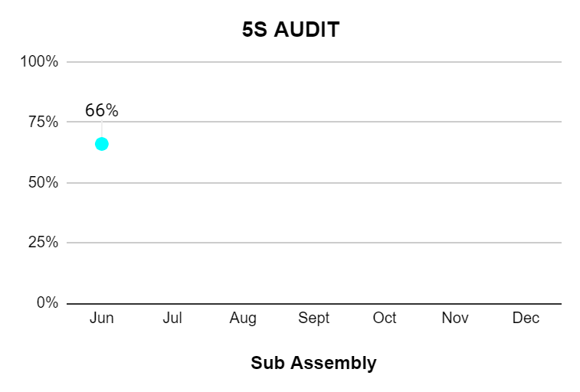
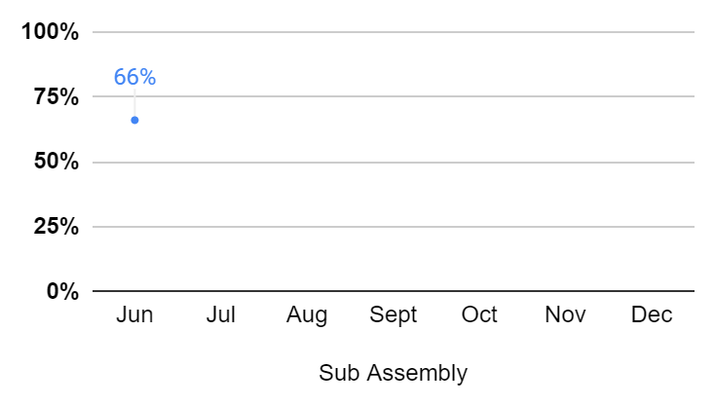
Sub assembly floor
Score: 66%
Improvement Areas:
Machines and pieces of equipment are left on workbench after use.
Location of materials in workbenches is not clear and organised
Worn out reflective demarcation tape(Suggest painting)
Machines and tools are not frequently cleaned
Tank level QC test rig to have a better routing
Link

Slide 4
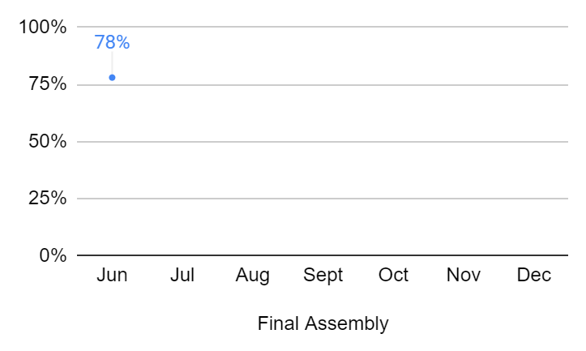
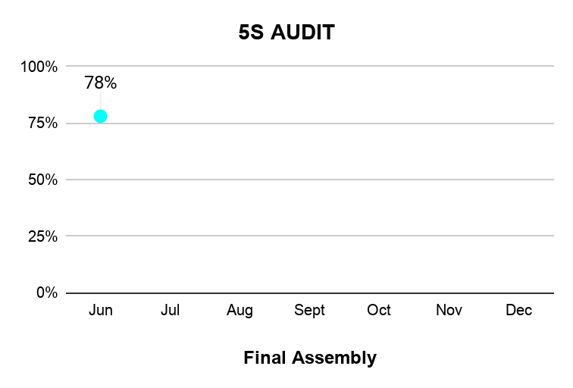
Final assembly + Loading Bay
Score: 78%
Improvement Areas:
Unnecessary items on Deployment and calibration rack
Use labels for uplanned conditions ie temporary storage
Dividing lines not to standard
Dirty equipments with dust at QC area, dirty lockers
Unorganized refill hoses at QC area
Equipments not in regular use to have designated location and organized
Link

Slide 5
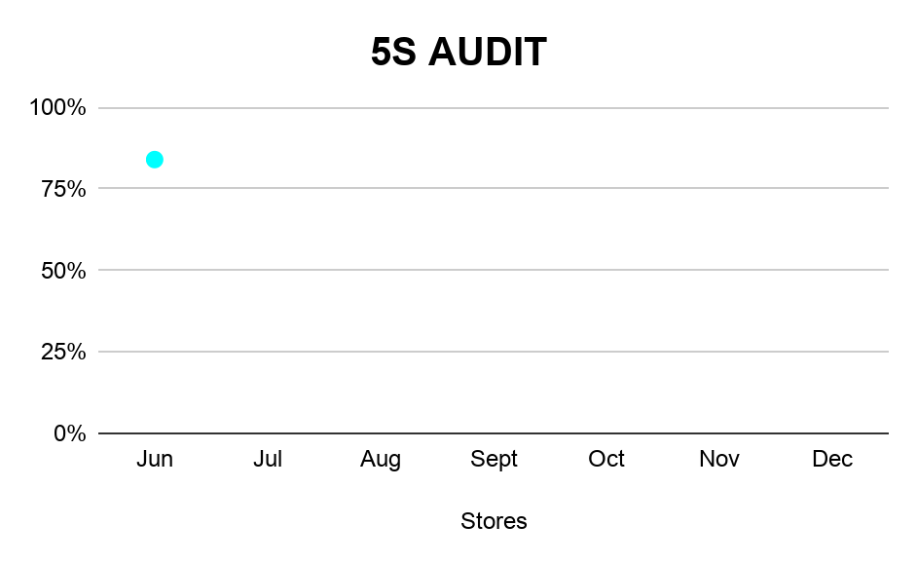
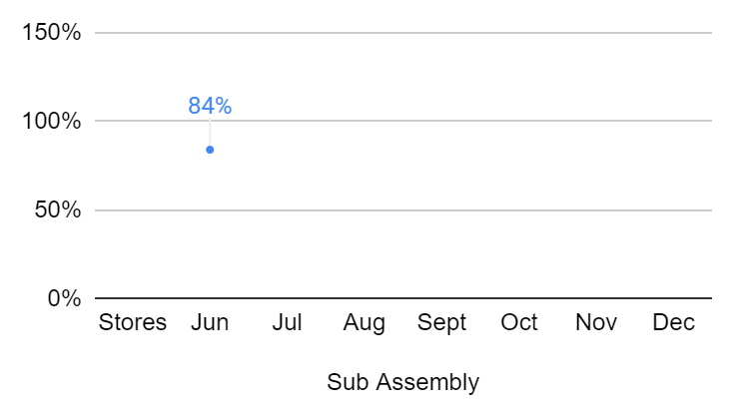
Stores(Main & Inbound)
Score: 84%
Improvement Areas:
Designate areas for Flasks
Designate area for staff PPE
Organise frequently used tools in rack to a bin
Implement a mirror system for parts/spare parts location in racks
Scrap section in Loading bay to be improved
Link

Slide 6
Further Recommendations
Involve technicians in Audits(I.e Auditors and auditees)
A senior manager to participate in the audit process at least once every quarter

Slide 7
y.koech@kokonetworks.com

